Slide 1
Machine Learning with Scikit-learn
Supervised Machine Learning

Slide 2
Two models to focus today
KNN – K-nearest Neighbors
Regression – Simple and Multiple Regression
Measure a model performance
Training data + test data
Cross-validation
80% (Training) + 20 (Test) %

Slide 3

What is supervised machine learning?
Bicep dead lift squat bench press strength
60 70 100 strong
5 24 30 20 weak
Machine learning is the process whereby:
Computers are given the ability to learn to make decisions from data without being explicitly programmed.

Slide 4
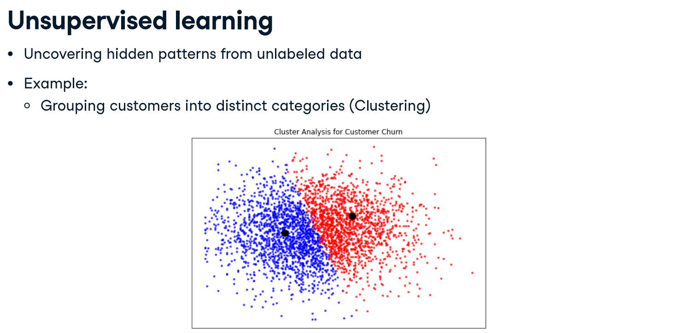
Churn – who will unsubscribe services
No Churn – who will not unsubscribe

Slide 5
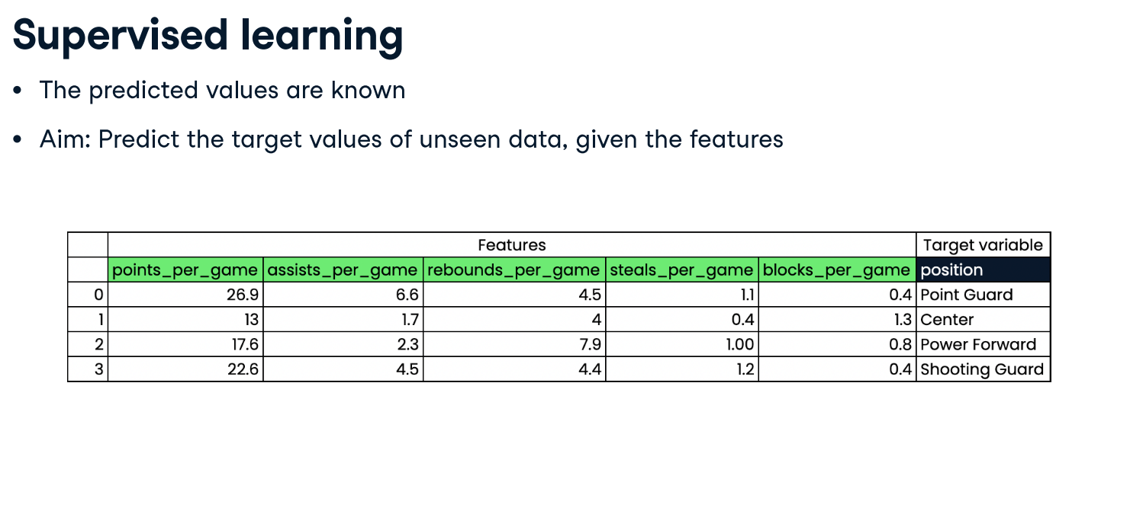

Slide 6
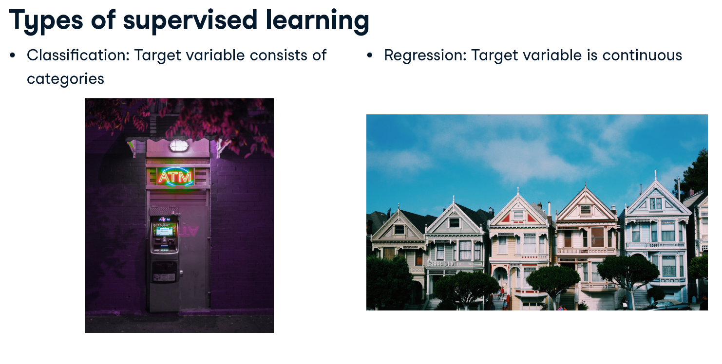

Slide 7
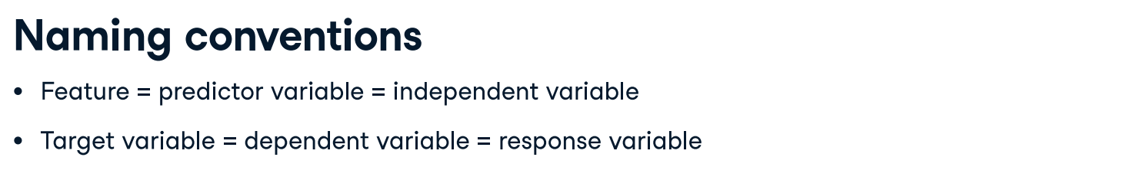
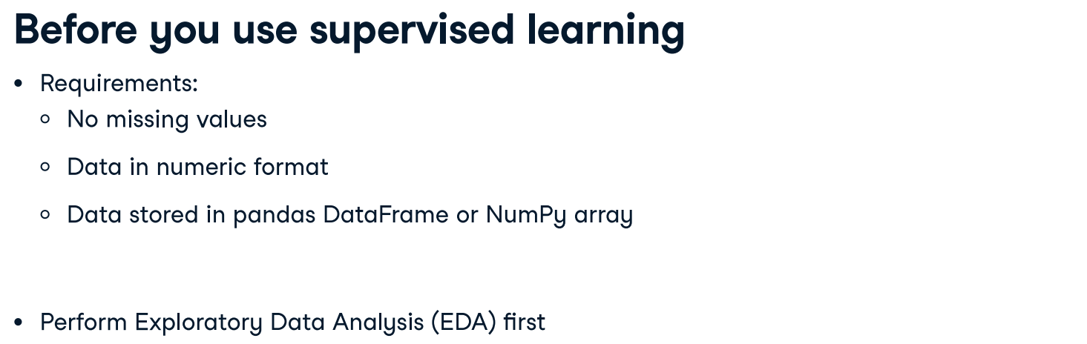

Slide 8
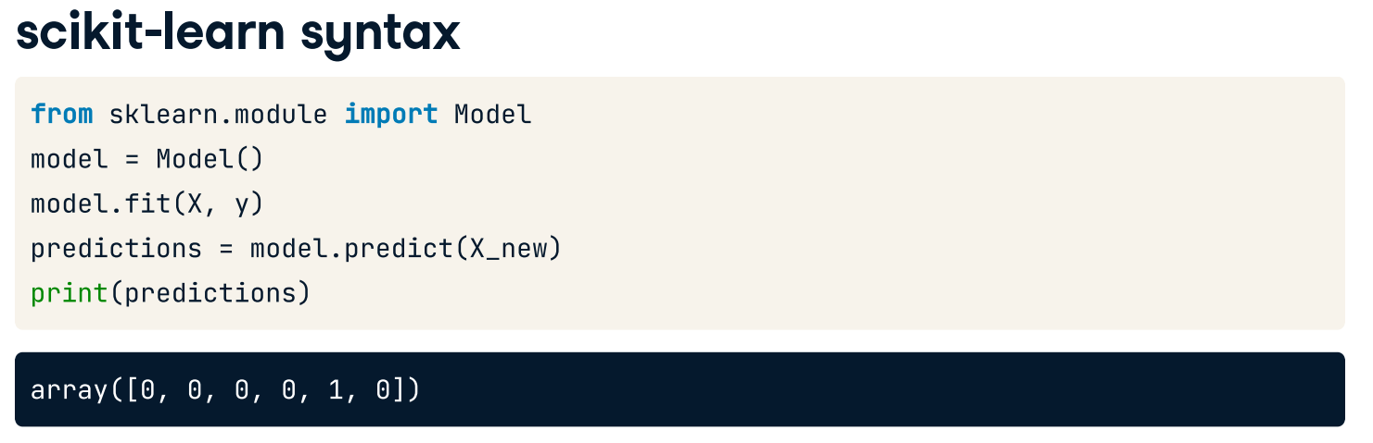

Slide 9
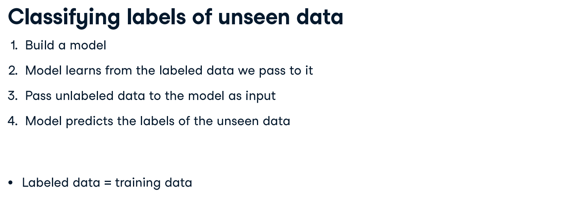
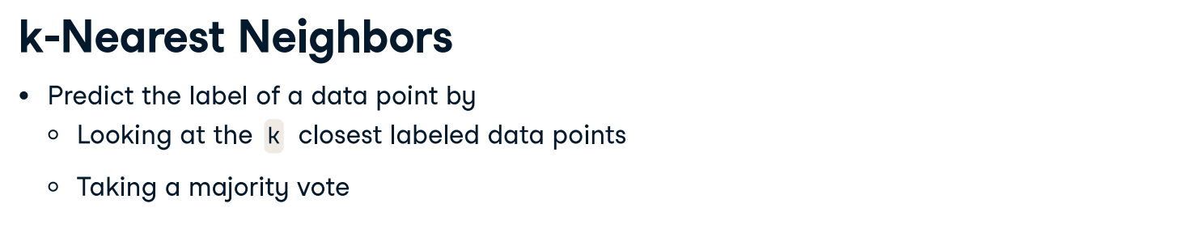

Slide 10
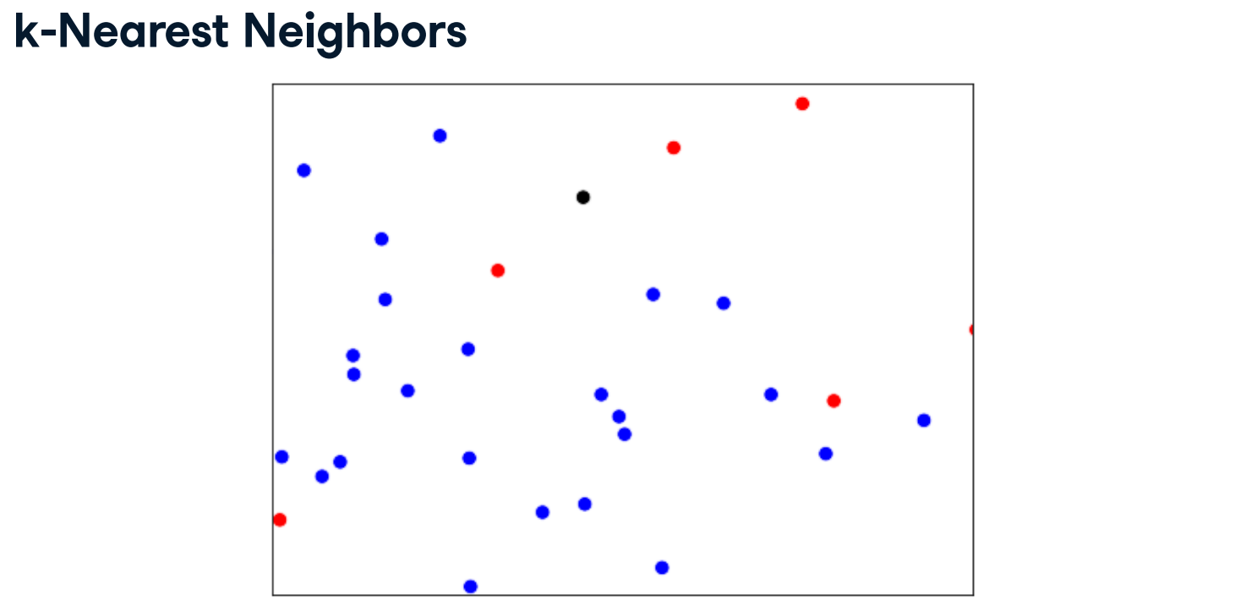

Slide 11
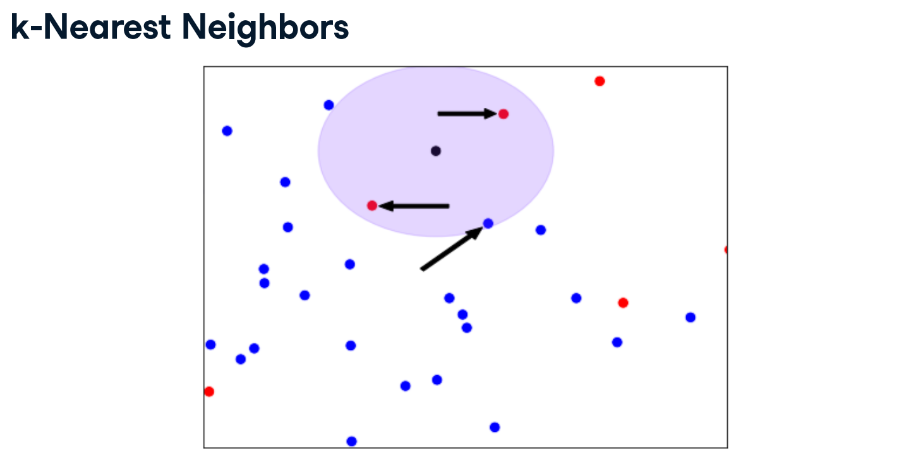

Slide 12
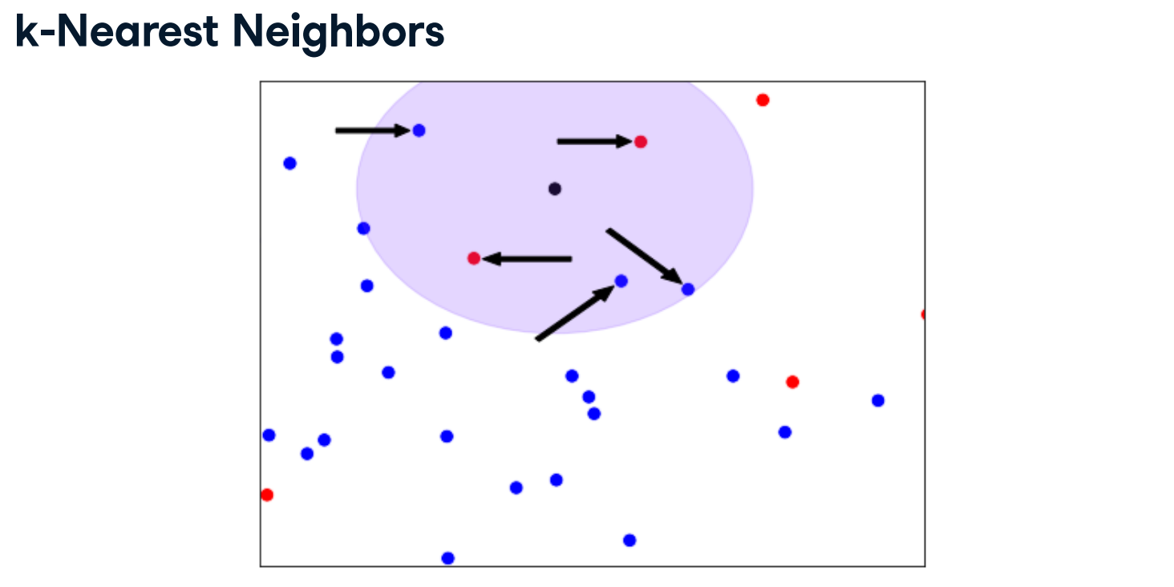

Slide 13
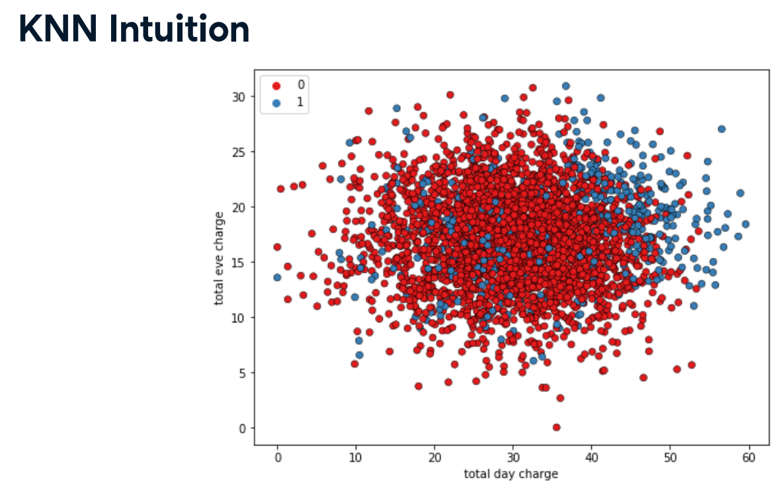
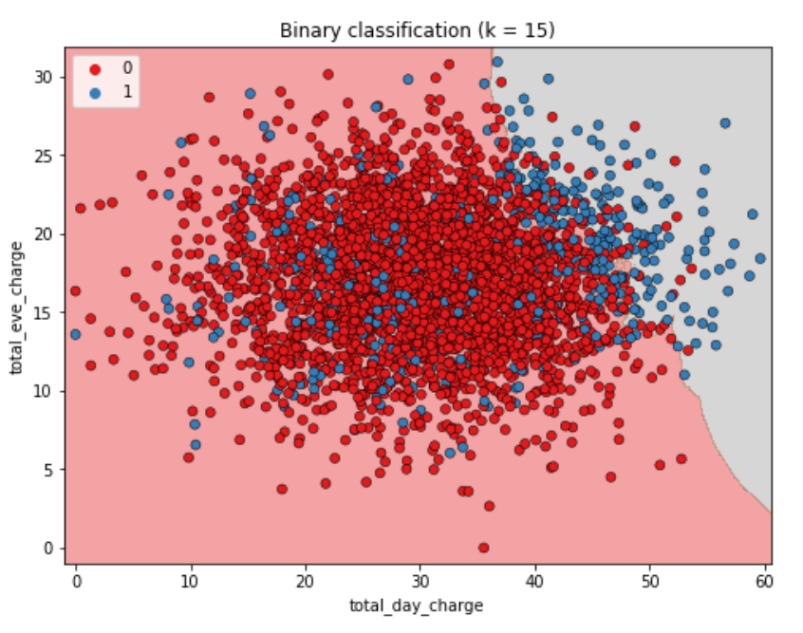
To build intuition for KNN, let's look at this scatter plot displaying total evening charge against total day charge for customers of a telecom company. The observations are colored in blue for customers who have churned, and red for those who have not churned.
Here we have visualized the results of a KNN algorithm where the number of neighbors is set to 15. KNN creates a decision boundary to predict if customers will churn. Any customers in the area with a gray background are predicted to churn, and those in the area with a red background are predicted to not churn. This boundary would be used to make predictions on unseen data.

Slide 14
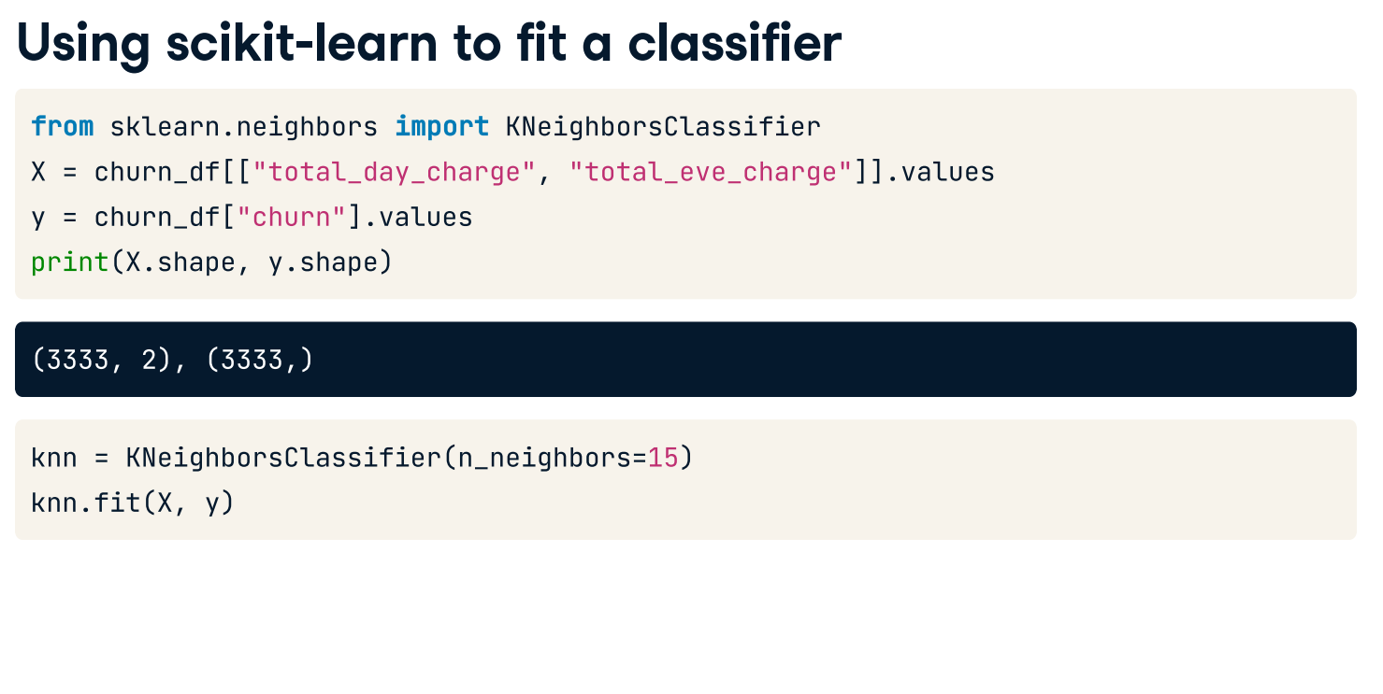

Slide 15
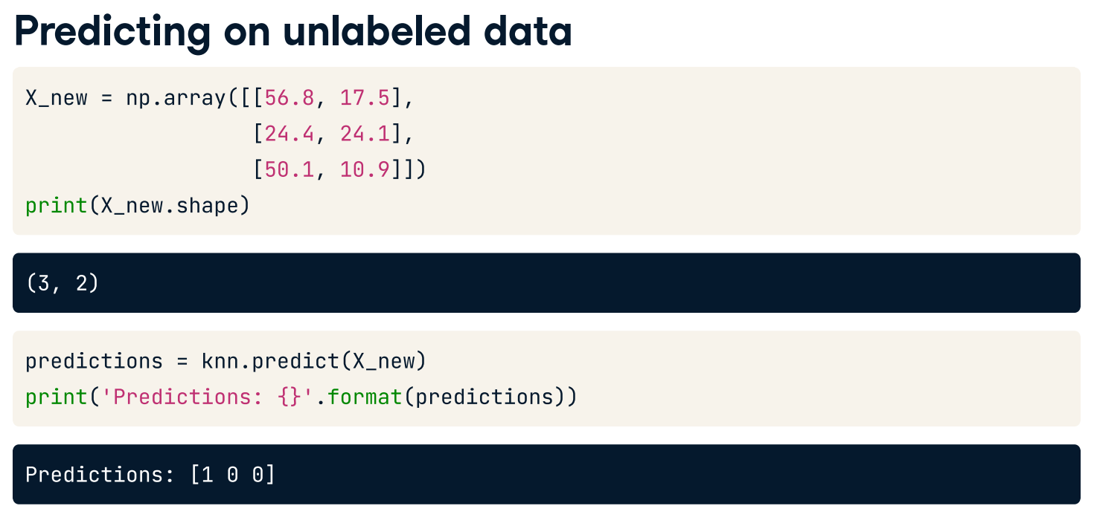
1 corresponds to churn and 0 corresponds to no churn

Slide 16
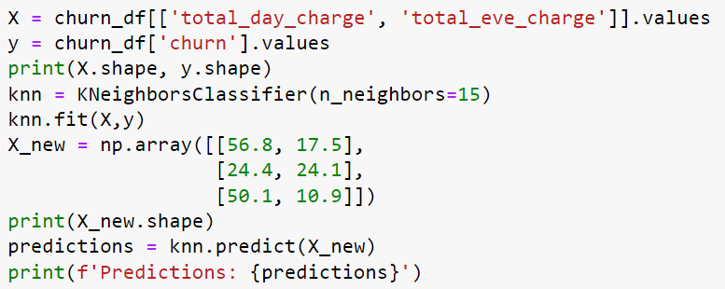
k-Nearest Neighbors: Fit
In this exercise, you will build your first classification model using the churn_df dataset, it can be loaded from churn_df.csv.
The features to use will be "account_length" and "customer_service_calls". The target, "churn", needs to be a single column with the same number of observations as the feature data.
You will convert the features and the target variable into NumPy arrays, create an instance of a KNN classifier, and then fit it to the data.
Instructions
Import KNeighborsClassifier from sklearn.neighbors.
Create an array called X containing values from the "account_length" and "customer_service_calls" columns, and an array called y for the values of the "churn" column.
Instantiate a KNeighborsClassifier called knn with 6 neighbors.
Fit the classifier to the data using the .fit() method.
This is not a solution. It is provided as a reference.

Slide 17
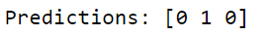
k-Nearest Neighbors: Predict
Now you have fit a KNN classifier, you can use it to predict the label of new data points. All available data was used for training, however, fortunately, there are new observations available, X_new.
The model knn, which you created and fit the data in the last exercise, will be used. You will use your classifier to predict the labels of a set of new data points:
X_new = np.array([[30.0, 17.5],
[107.0, 24.1],
[213.0, 10.9]])
This is not a solution. It is provided as a reference.
Instructions
Create y_pred by predicting the target values of the unseen features X_new.
Print the predicted labels for the set of predictions.

Slide 18
Measuring model performance

Slide 19
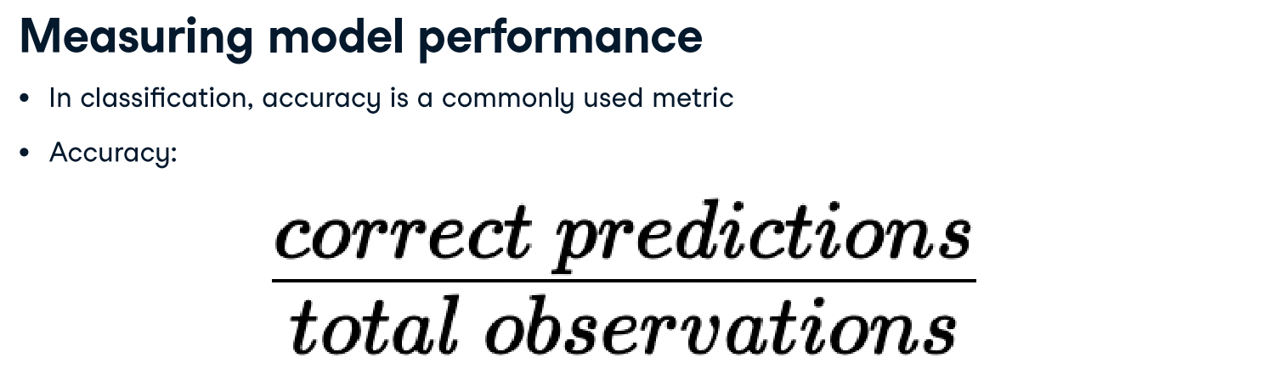
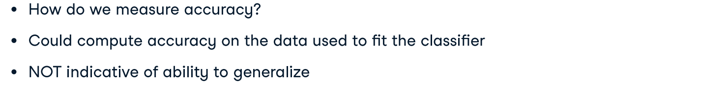

Slide 20
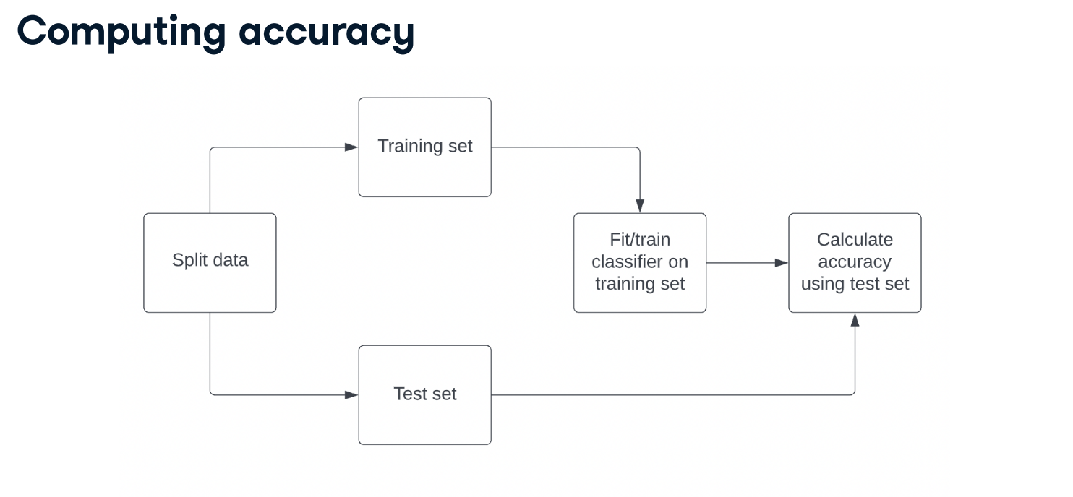

Slide 21
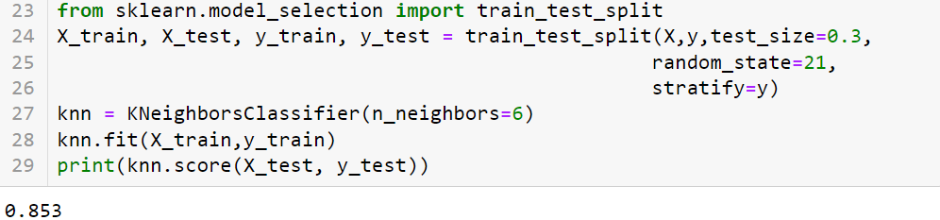
It is best practice to ensure our split reflects the proportion of labels in our data. So, if churn occurs in 10% of observations, we want 10% of labels in our training and test sets to represent churn. We achieve this by setting stratify equal to y.
from sklearn.model_selection import train_test_split
X = …
y = …
X_train, X_test, y_train, y_test = train_test_split(X,y,test_size=0.3,
random_state=21,
stratify=y)
knn = KNeighborsClassifier(n_neighbors=2)
knn.fit(X_train,y_train)
print(knn.score(X_test, y_test))
10%
70%
20%
10%
68%
2%
20%
8%
63
7%
27
3%

Slide 22
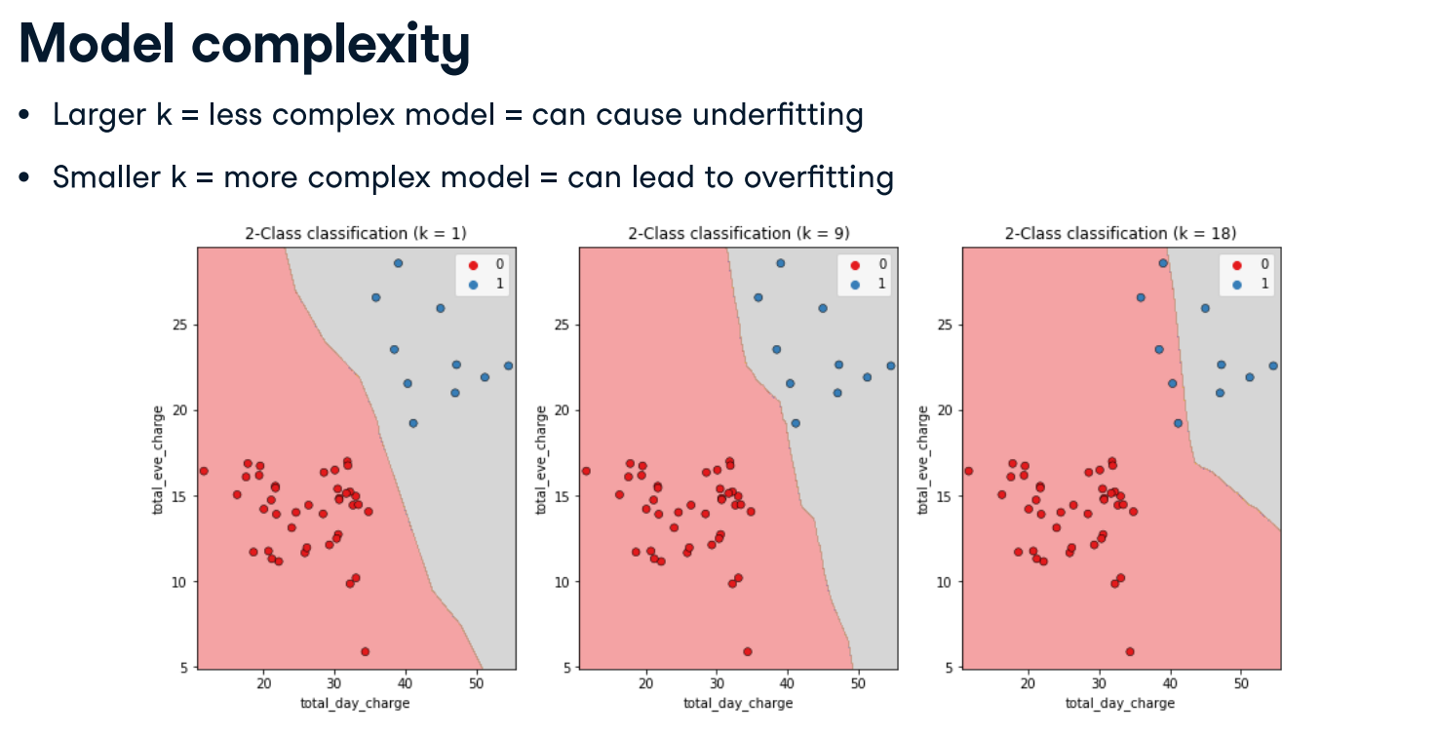
Recall that we discussed decision boundaries, which are thresholds for determining what label a model assigns to an observation. In the image shown, as k increases, the decision boundary is less affected by individual observations, reflecting a simpler model. Simpler models are less able to detect relationships in the dataset, which is known as underfitting. In contrast, complex models can be sensitive to noise in the training data, rather than reflecting general trends. This is known as overfitting.

Slide 23
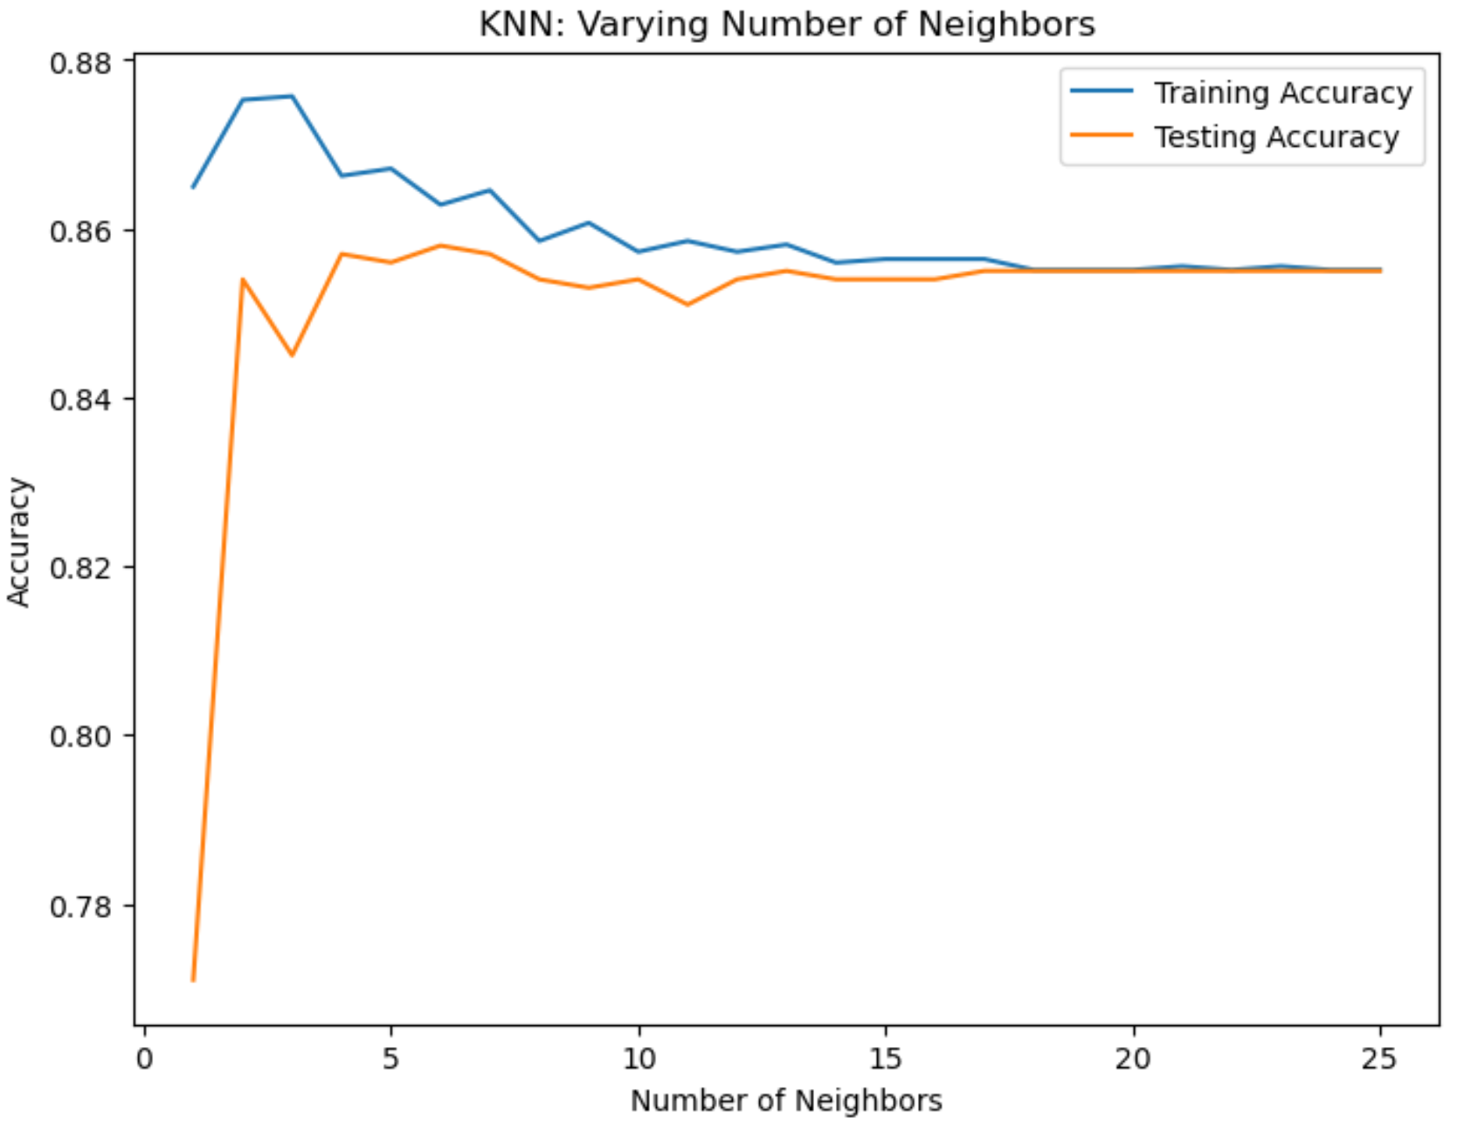
train_accuracies = {}
test_accuracies = {}
neighbors = np.arange(1,26)
print(neighbors)
for neighbor in neighbors:
knn = KNeighborsClassifier(n_neighbors=neighbor)
knn.fit(X_train,y_train)
train_accuracies[neighbor] = knn.score(X_train, y_train)
test_accuracies[neighbor] = knn.score(X_test, y_test)
#print(train_accuracies.values())
print(test_accuracies.values())
my_train = list(train_accuracies.values())
my_test = list(test_accuracies.values())
plt.figure(figsize=(8,6))
plt.title('KNN: Varying Number of Neighbors')
plt.plot(neighbors, my_train, label='Training Accuracy')
plt.plot(neighbors, my_test, label='Testing Accuracy')
plt.legend()
plt.xlabel('Number of Neighbors')
plt.ylabel('Accuracy')
plt.show()
Here's the result! As k increases beyond 15, we see overfitting where performance plateaus on both test and training sets, as indicated in this plot. Peak occurs at around 16.

Slide 24
Practice
NumPy arrays have been created for you containing the features as X and the target variable as y. You will split them into training and test sets, fit a KNN classifier to the training data, and then compute its accuracy on the test data using the .score() method.
Instructions:
Import train_test_split from sklearn.model_selection.
Create Numpy arrays having all columns, except churn, as features X, and target variable, churn, as target variable y
Split X and y into training and test sets, setting test_size equal to 20%, random_state to 42, and ensuring the target label proportions reflect that of the original dataset.
Set k = 5
Fit the knn model to the training data.
Compute and print the model's accuracy for the test data. (The score is 0.8740629685157422)
# Import the module
from sklearn.model_selection import train_test_split
X = churn_df.drop("churn", axis=1).values
y = churn_df["churn"].values
:
:
:
from sklearn.model_selection import train_test_split
X = churn_df.drop("churn", axis=1).values
y = churn_df["churn"].values
print(X.shape, y.shape)
# Split into training and test sets
X_train, X_test, y_train, y_test = train_test_split(X, y, test_size=0.2, random_state=42, stratify=y)
knn = KNeighborsClassifier(n_neighbors=5)
# Fit the classifier to the training data
knn.fit(X_train, y_train)
# Print the accuracy
print(knn.score(X_test, y_test))

Slide 25
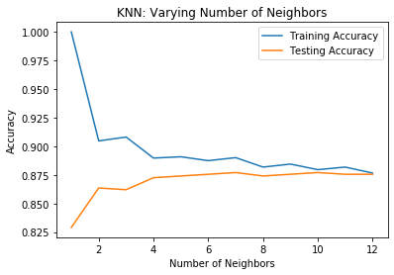
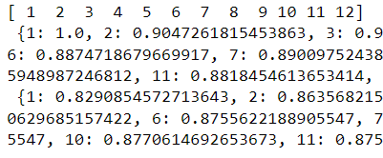
Practice – Exercise 3: Overfitting and underfitting
Interpreting model complexity is a great way to evaluate performance when utilizing supervised learning. Your aim is to produce a model that can interpret the relationship between features and the target variable, as well as generalize well when exposed to new observations.
You will generate accuracy scores for the training and test sets using a KNN classifier with different n_neighbor values, which you will plot in the next exercise.
The training and test sets have been created from the churn_df dataset and preloaded as X_train, X_test, y_train, and y_test.
Instructions
Create neighbors as a numpy array of values from 1 up to and including 12.
Instantiate a KNN classifier, with the number of neighbors equal to the neighbor iterator.
Fit the model to the training data.
Calculate accuracy scores for the training set and test set separately using the .score() method, and assign the results to the index of the train_accuracies and test_accuracies dictionaries, respectively.
Visual the accuracy

Slide 26
#Ex3 Over/Underfitting
# Create neighbors
neighbors = np.arange(1, 13)
train_accuracies = {}
test_accuracies = {}
for neighbor in neighbors:
# Set up a KNN Classifier
knn = KNeighborsClassifier(n_neighbors=neighbor)
# Fit the model
knn.fit(X_train, y_train)
# Compute accuracy
train_accuracies[neighbor] = knn.score(X_train, y_train)
test_accuracies[neighbor] = knn.score(X_test, y_test)
print(neighbors, '\n', train_accuracies, '\n', test_accuracies)
# Add a title
plt.title("KNN: Varying Number of Neighbors")
my_train = list(train_accuracies.values())
my_test = list(test_accuracies.values())
# Plot training accuracies
plt.plot(neighbors, my_train, label="Training Accuracy")
# Plot test accuracies
plt.plot(neighbors, my_test, label="Testing Accuracy")
plt.legend()
plt.xlabel("Number of Neighbors")
plt.ylabel("Accuracy")
# Display the plot
plt.show()

Slide 27
Regression with Scikit-Learn

Slide 28
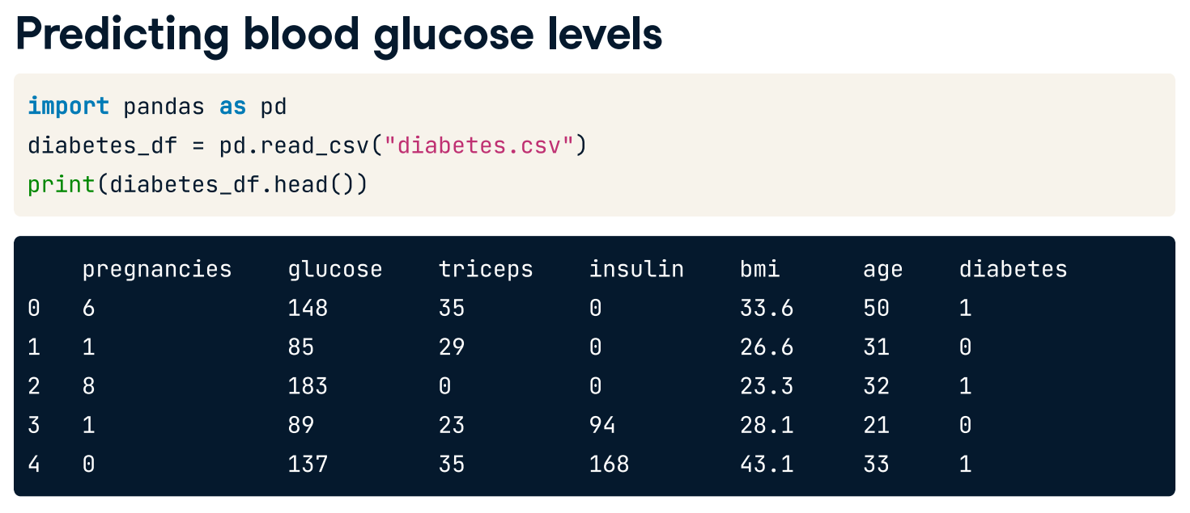

Slide 29
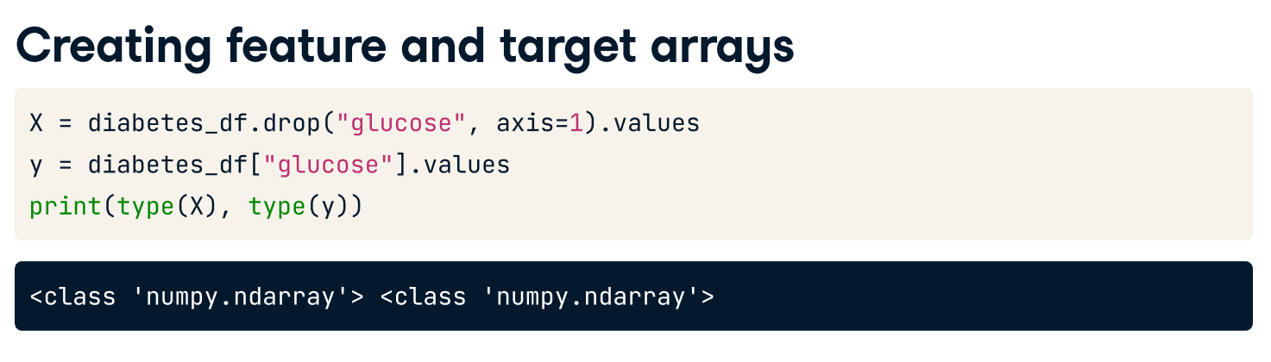
diabetes_df = pd.read_csv('diabetes.csv', index_col = 0)
print(diabetes_df.shape)
#subset row for bmi not equal to 0
diabetes_df = ………..
print(diabetes_df.shape)
#subset for glucose not equal to 0
diabetes_df = …………
print(diabetes_df.shape)
diabetes.head()
diabetes_df = pd.read_csv('diabetes.csv', index_col = 0)
print(diabetes_df.shape)
diabetes_df = diabetes_df[diabetes_df['bmi'] != 0]
print(diabetes_df.shape)
diabetes_df = diabetes_df[diabetes_df['glucose'] != 0]
print(diabetes_df.shape)
diabetes.head()

Slide 30
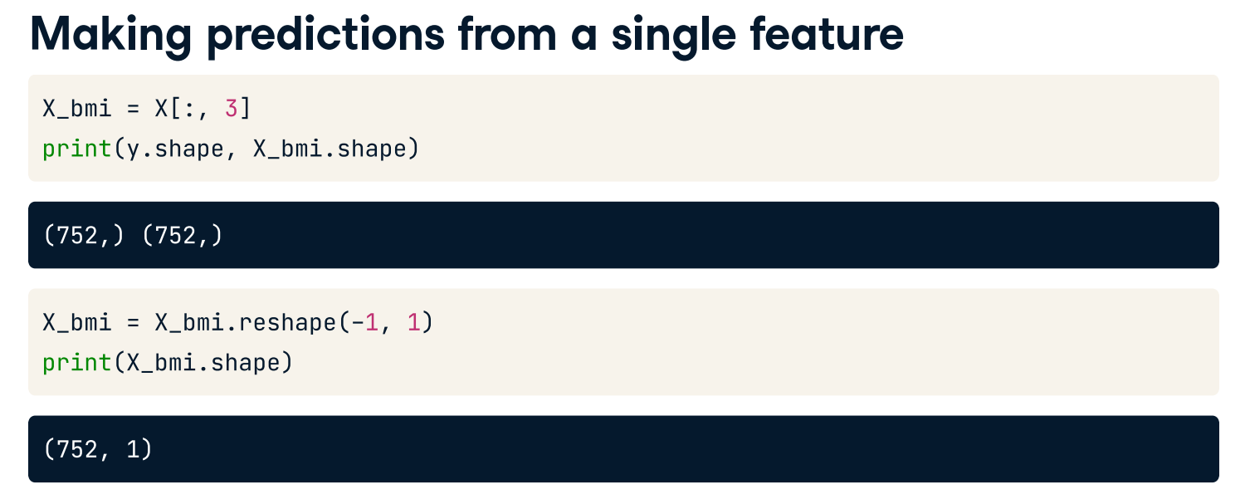
To start, let's try to predict blood glucose levels from a single feature: body mass index. To do this, we slice out the BMI column of X, which is the fourth column, storing as the variable X_bmi. Checking the shape of y and X_bmi, we see that they are both one-dimensional arrays. This is fine for y, but our features must be formatted as a two-dimensional array to be accepted by scikit-learn. To convert the shape of X_bmi we apply NumPy’s .reshape method, passing minus one followed by one. Printing the shape again shows X_bmi is now the correct shape for our model.

Slide 31
diabetes_df = pd.read_csv('diabetes.csv', index_col = 0)
print(diabetes_df.shape)
diabetes_df = diabetes_df[diabetes_df[‘bmi’] != 0]
diabetes_df = diabetes_df[diabetes_df[‘glucose’] != 0]
X = diabetes_df.drop('glucose', axis=1).values
# X_bmi = diabetes_df['bmi'].values
y = diabetes_df['glucose'].values
X_bmi = X[:,3]
X_bmi = X_bmi.reshape(-1,1)
plt.scatter(X_bmi, y, s = 25, color = 'blue')
plt.ylabel('Blood Glucose (mg/dl)')
plt.xlabel('Body Mass Index')
#plt.grid(True)
plt.show()

Slide 32
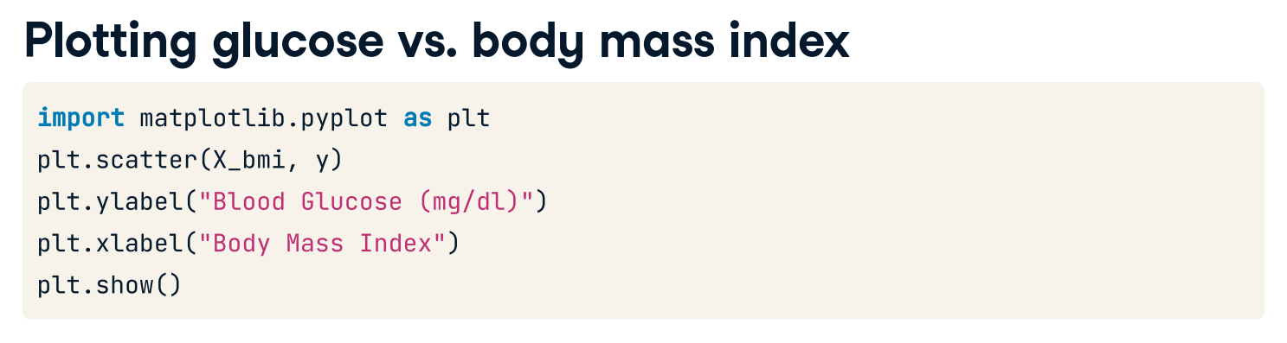
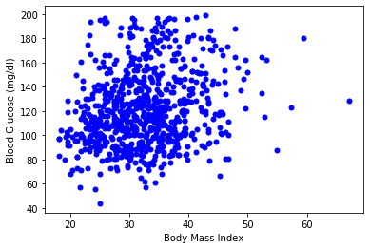
You might get different color. But you can change the color
by having color = ‘blue’ in scatter()

Slide 33
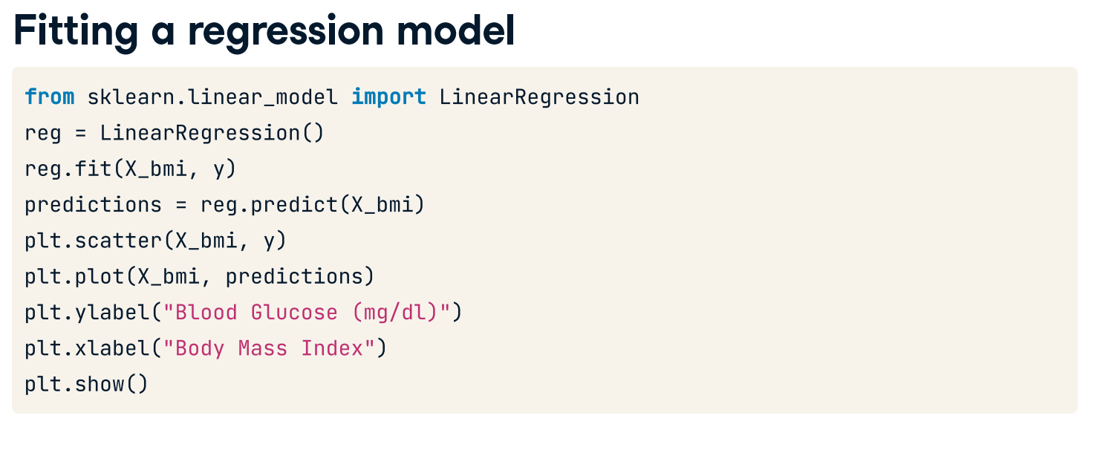
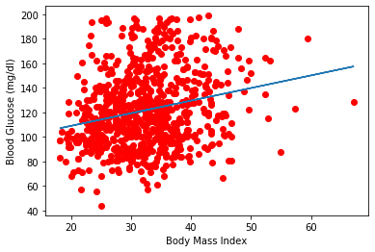

Slide 34
Let’s practice
Creating features
In this exercise, you will work with a dataset called sales_df (loaded from sales_df.csv), which contains information on advertising campaign expenditure across different media types, and the number of dollars generated in sales for the respective campaign. The dataset has been preloaded for you. Here are the first two rows:
tv radio social_media sales
1 13000.0 9237.76 2409.57 46677.90
41000.0 15886.45 2913.41 150177.83
You will use the advertising expenditure as features to predict sales values, initially working with the "radio" column. However, before you make any predictions you will need to create the feature and target arrays, reshaping them to the correct format for scikit-learn.
Create X, an array of the values from the sales_df DataFrame's "radio" column.
Create y, an array of the values from the sales_df DataFrame's "sales" column.
Reshape X into a two-dimensional NumPy array.
Print the shape of X and y.

Slide 35
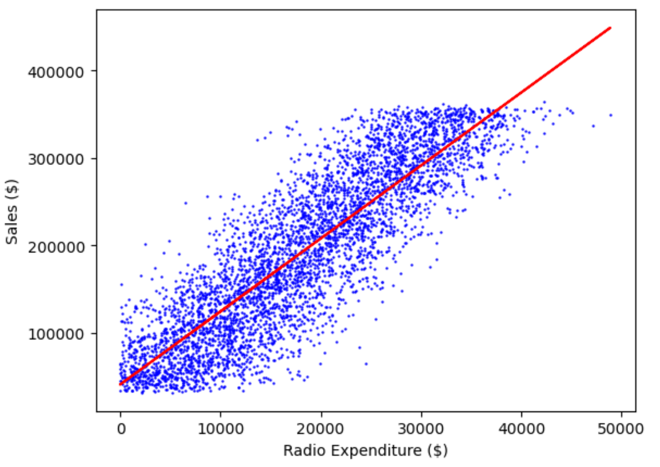
Building a linear regression model
Now you have created your feature and target arrays, you will train a linear regression model on all feature and target values.
As the goal is to assess the relationship between the feature and target values there is no need to split the data into training and test sets.
Instantiate a linear regression model.
Predict sales values using X, storing as predictions.
Print five prediction values
Visualizing a linear regression model
Now you have built your linear regression model and trained it using all available observations, you can visualize how well the model fits the data. This allows you to interpret the relationship between radio advertising expenditure and sales values.
The variables X, an array of radio values, y, an array of sales values, and predictions, an array of the model's predicted values for y given X, have all been preloaded for you from the previous exercise.
Create a scatter plot visualizing y against X, with observations in blue.
Draw a red line plot displaying the predictions against X.
Display the plot.

Slide 36
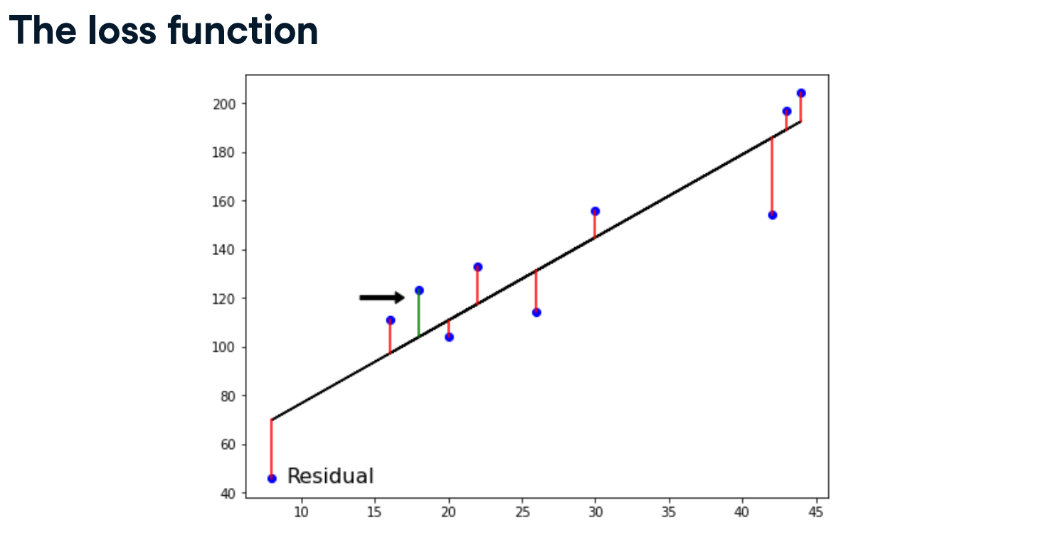
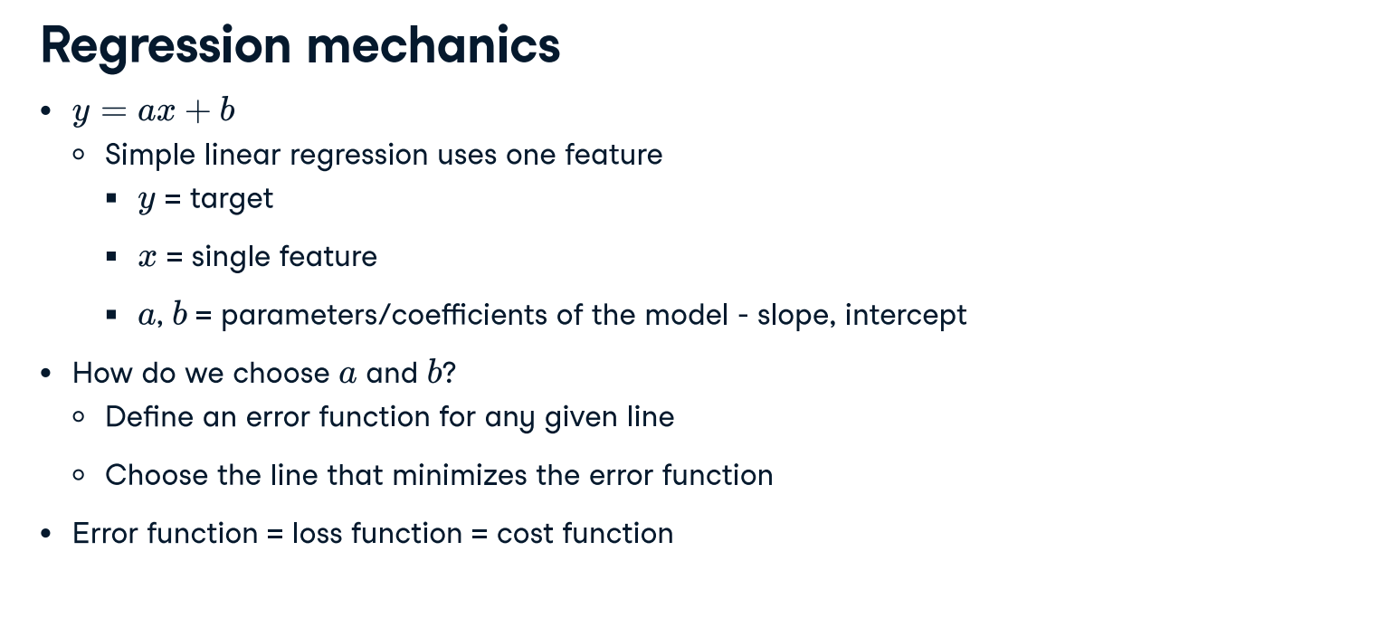

Slide 37
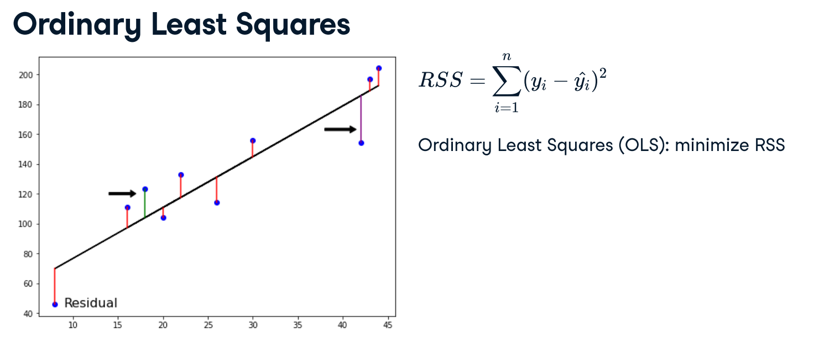
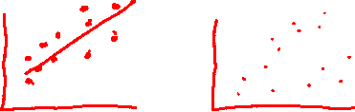
The distance is called a residual. We could try to minimize the sum of the residuals, each negative residual. To avoid this, we square the residuals. By adding all the squared residuals, we calculate the residual sum of squares, or RSS. This type of linear regression is called Ordinary Least Squares, or OLS, where we aim to minimize the RSS.

Slide 38
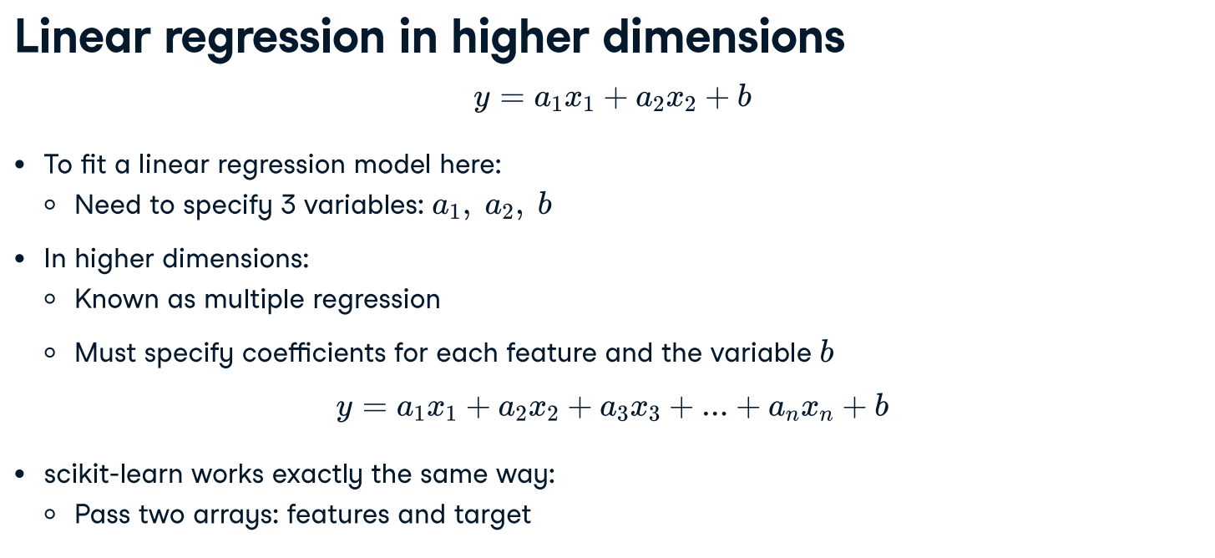

Slide 39
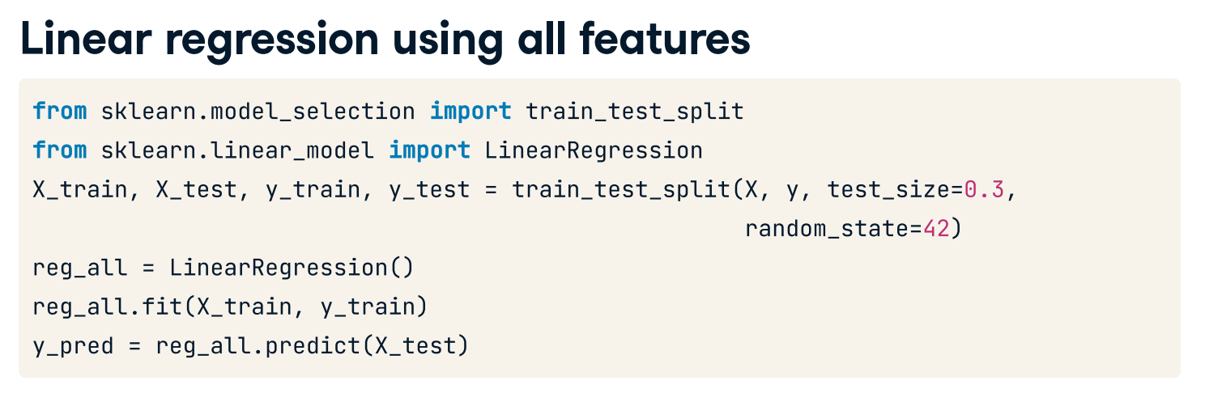

Slide 40
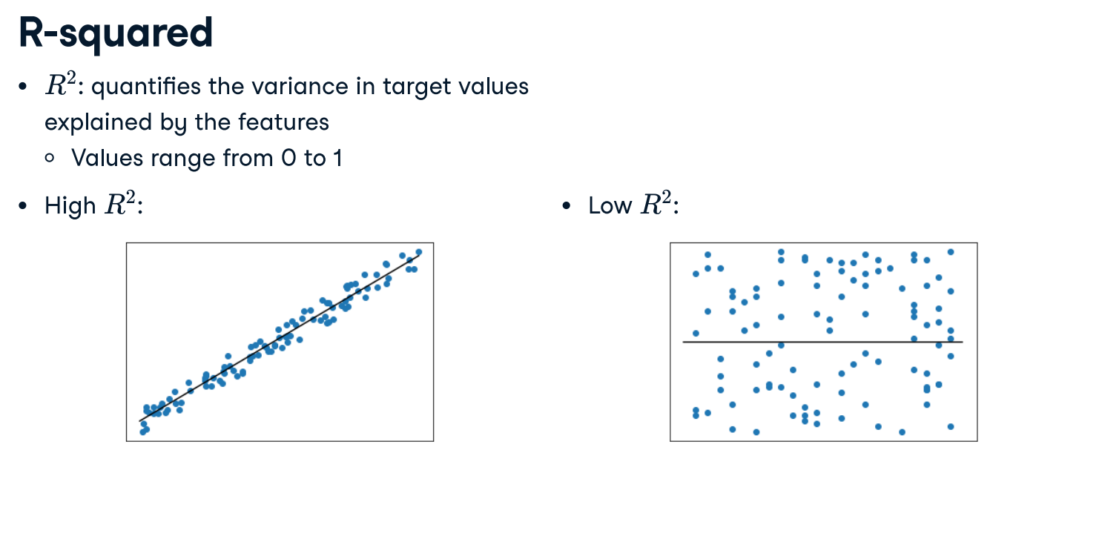

Slide 41
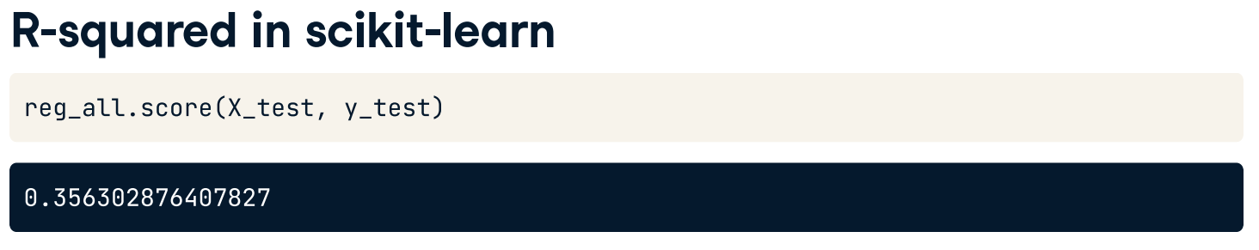
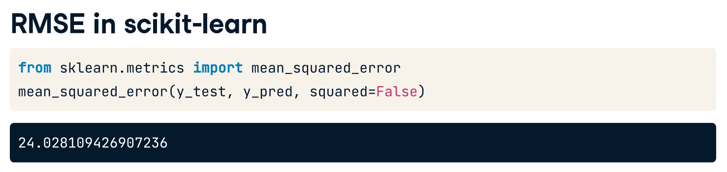
To compute R-squared, we call the model’s .score() method, passing the test features and targets. Here the features only explain about 35 percent of blood glucose level variance.
The model has an average error for blood glucose levels of around 24 milligrams per deciliter.

Slide 42
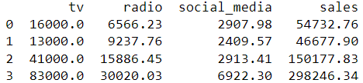
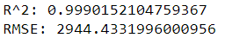
Fit and predict for regression
Now you have seen how linear regression works, your task is to create a multiple linear regression model using all of the features in the sales_df dataset. As a reminder, here are the first two rows:
You will then use this model to predict sales based on the values of the test features.
Create X, an array containing values of all features in sales_df, and y, containing all values from the "sales" column.
Instantiate a linear regression model.
Fit the model to the training data.
Create y_pred, making predictions for sales using the test features.
Print the first two values of y_pred and y_test
Calculate the model's R-squared score by passing the test feature values and the test target values to an appropriate method.
Calculate the model's root mean squared error using y_test and y_pred.
Print r_squared and rmse.

Slide 43
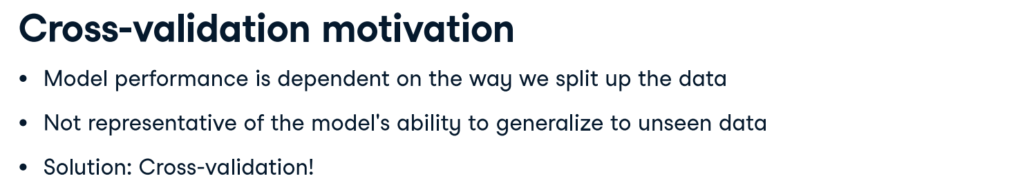
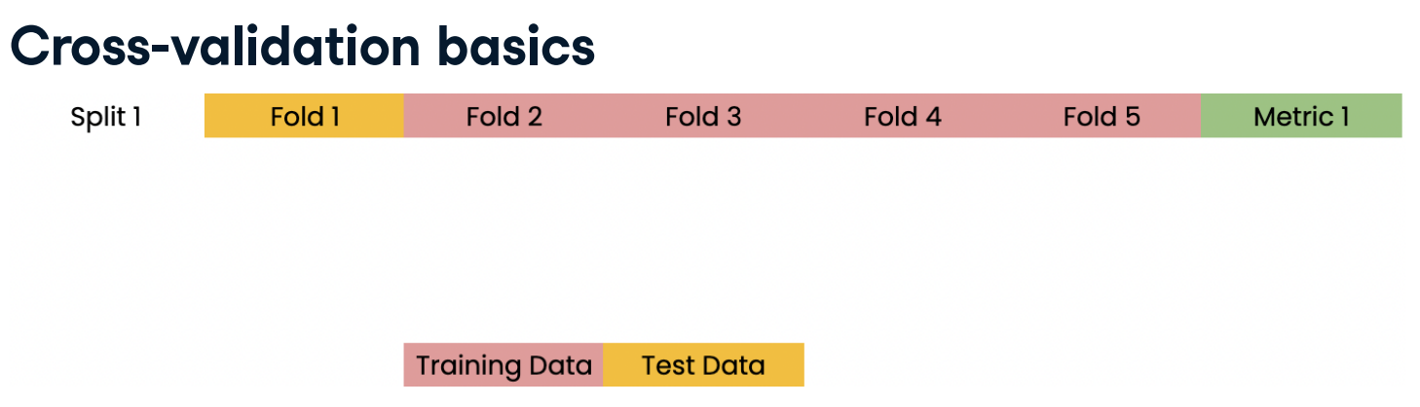
We begin by splitting the dataset into five groups or folds. Then we set aside the first fold as a test set, fit our model on the remaining four folds, predict on our test set, and compute the metric of interest, such as R-squared.

Slide 44
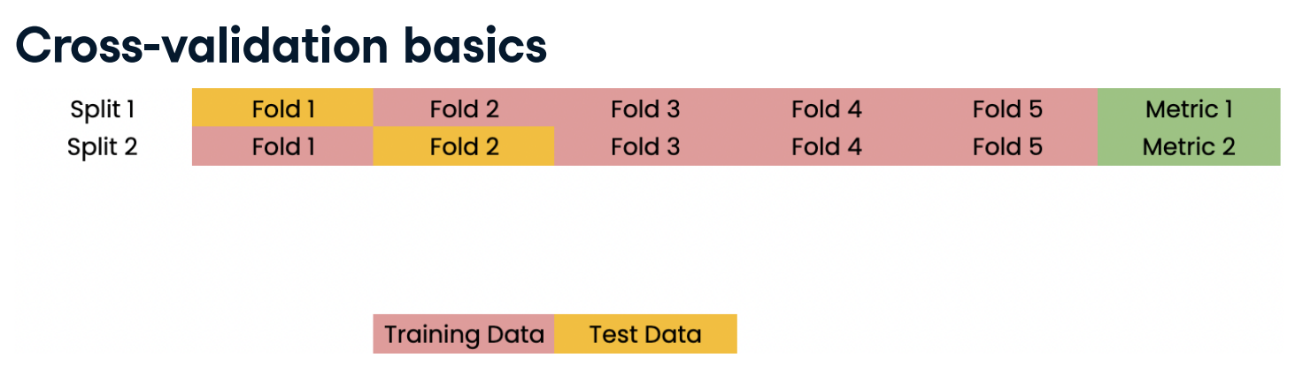
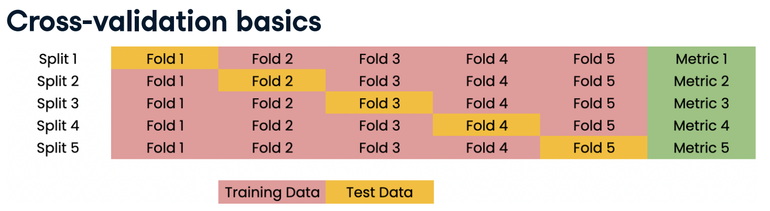

Slide 45
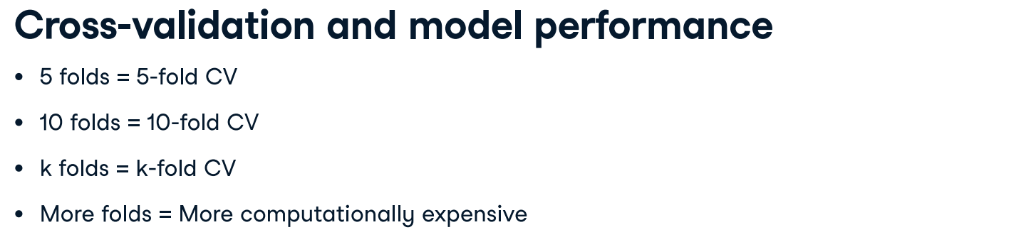
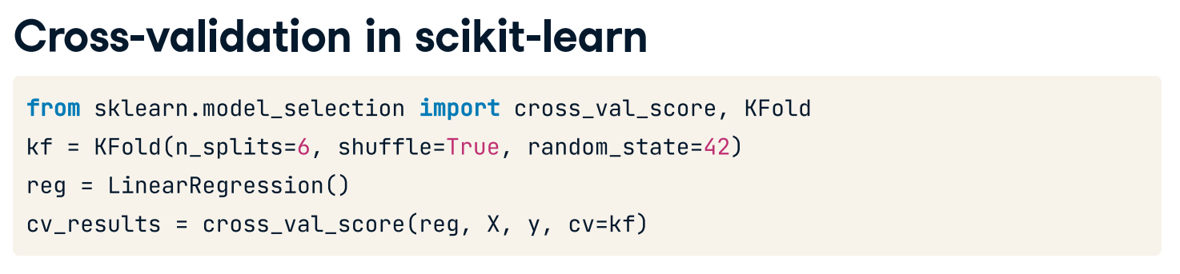

Slide 46


Slide 47

Cross-validation for R-squared
Cross-validation is a vital approach to evaluating a model. It maximizes the amount of data that is available to the model, as the model is not only trained but also tested on all of the available data.
In this exercise, you will build a linear regression model, then use 6-fold cross-validation to assess its accuracy for predicting sales using social media advertising expenditure. You will display the individual score for each of the six-folds.
The sales_df dataset shall be split into y for the target variable (sales), and X for the features (radio and social media).
Instructions
Import KFold and cross_val_score.
Create X and y according to the requirements above.
Create kf by calling KFold(), setting the number of splits to six, shuffle to True, and setting a seed of 5.
Perform cross-validation using reg on X and y, passing kf to cv.
Print the cv_scores.
Calculate and print the mean of the cv_scores results.
Calculate and print the standard deviation of cv_scores.
Display the 95% confidence interval for your results using np.quantile().

Slide 48
#slide 33 - 34
sales_df = pd.read_csv('sales_df.csv', index_col = 0)
print(sales_df)
# Create X from the radio column's values
X = sales_df["radio"].values
# Create y from the sales column's values
y = sales_df["sales"].values
# Reshape X
X = X.reshape(-1, 1)
# Check the shape of the features and targets
print(X.shape, y.shape)
# Import LinearRegression
from sklearn.linear_model import LinearRegression
# Create the model
reg = LinearRegression()
# Fit the model to the data
reg.fit(X, y)
# Make predictions
predictions = reg.predict(X)
print(predictions[:5])
# Create scatter plot
plt.scatter(X, y, color="blue")
# Create line plot
plt.plot(X, predictions, color="red")
plt.xlabel("Radio Expenditure ($)")
plt.ylabel("Sales ($)")
# Display the plot
plt.show()
#Solution for slide 41
sales_df = pd.read_csv('sales_df.csv', index_col = 0)
# Create X and y arrays
print(sales_df.head())
X = sales_df.drop("sales", axis=1).values
y = sales_df["sales"].values
X_train, X_test, y_train, y_test = train_test_split(X, y, test_size=0.3, random_state=42)
# Instantiate the model
reg = LinearRegression()
# Fit the model to the data
reg.fit(X_train, y_train)
# Make predictions
y_pred = reg.predict(X_test)
print("Predictions: {}, Actual Values: {}".format(y_pred[:2], y_test[:2]))
# Compute R-squared
r_squared = reg.score(X_test, y_test)
# Compute RMSE
rmse = np.sqrt(mean_squared_error(y_test, y_pred))
# Print the metrics
print("R^2: {}".format(r_squared))
print("RMSE: {}".format(rmse))

Slide 49
#cross validation – slide 46
from sklearn.model_selection import KFold, cross_val_score
sales_df = pd.read_csv('sales_df.csv', index_col = 0)
# Create X and y arrays
print(sales_df.head())
#X = sales_df[[“radio", “social_media"]].values
X = sales_df.drop(["tv","sales"], axis=1).values
y = sales_df["sales"].values
# Create a KFold object
kf = KFold(n_splits=6, shuffle=True, random_state=5)
reg = LinearRegression()
# Compute 6-fold cross-validation scores
cv_scores = cross_val_score(reg, X, y, cv=kf)
# Print scores
print(f'CV scores: {cv_scores}')
# Print the mean
print(f'Mean: {np.mean(cv_scores)}')
# Print the standard deviation
print(f'STD: {np.std(cv_scores)}')
# Print the 95% confidence interval
print(f'Confidence interval: {np.quantile(cv_scores, [0.025, 0.975])}')

